Slide 1
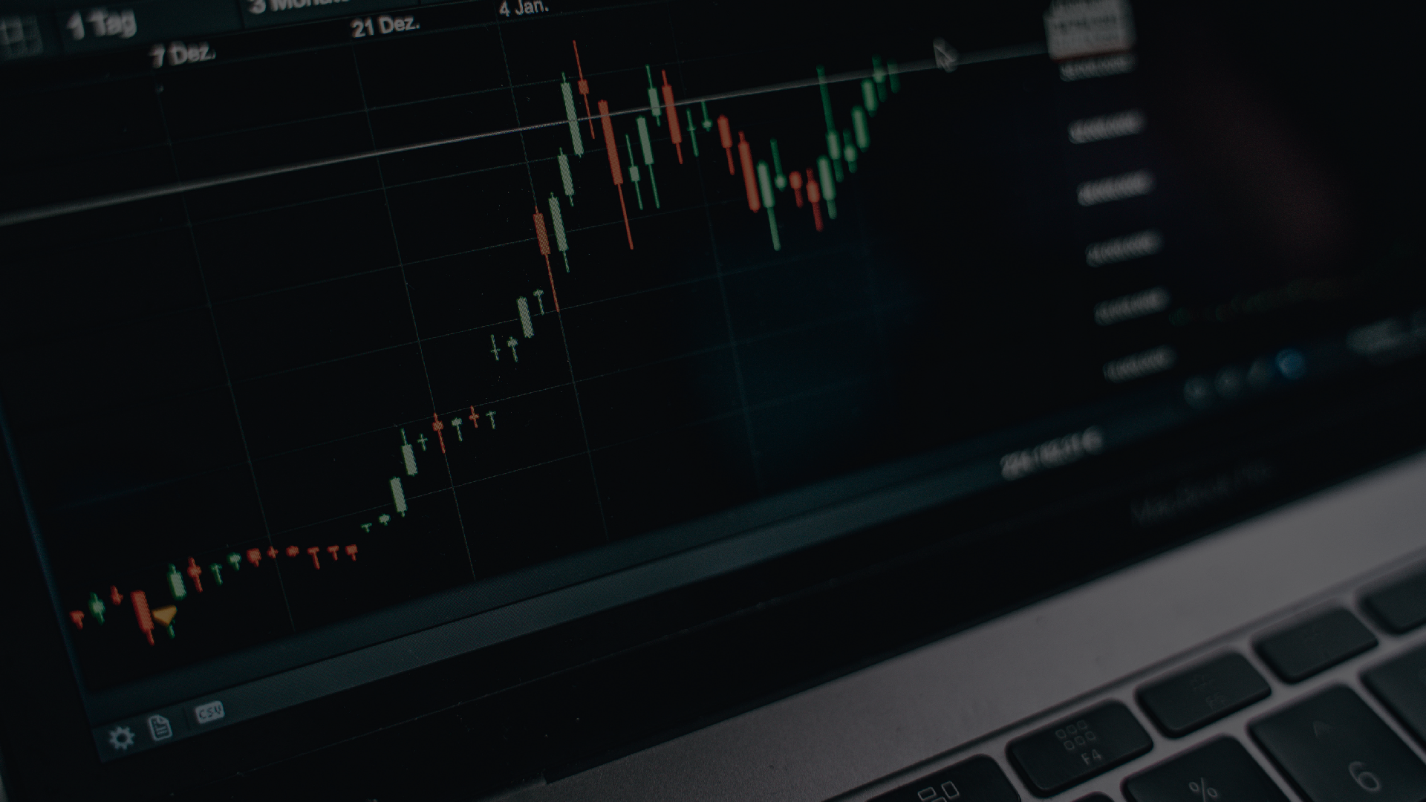

SAFE CRYPTO STOCKS
Simplifying Investment Platform
PRESENTING BY: RUCHITA JAIN

Slide 2
INTRODUCTION
SAFE CRYPTO STOCKS
The Stock Market Investment Platform makes investing easy and secure. It helps users track their portfolios, view real-time stock data, and learn about the market. Designed for both beginners and experienced investors, it simplifies complex tools and provides resources to make smarter financial decisions.

Slide 3
ABSTRACT
SAFE CRYPTO STOCKS
This project aims to build a user-friendly web application that equips users with the tools they need to manage their investment portfolios effectively. It offers real-time market data, portfolio tracking, market analysis, and educational resources, simplifying the investment process for both novice and experienced investors.

Slide 4
Existing System:
SAFE CRYPTO STOCKS
Portfolio Tracking Investors track stocks manually using spreadsheets, requiring frequent updates for accurate portfolio values.
Real-Time Data Access Users rely on multiple websites and news channels for stock prices, creating a fragmented experience without real-time updates in one place.
User Interface Limitations No unified platform for portfolio management, real-time tracking, and learning, leading to a complex, less intuitive experience.

Slide 5
Disadvantages
SAFE CRYPTO STOCKS
Advantages
User-Friendly Interface Increased Investor Confidence Multi-Language and Currency Support
Time-Consuming and Inefficient
Lack of Real-Time Data
Limited Analysis Tools
Error-Prone and Difficult to Manage.

Slide 6

OUTCOMES
SAFE CRYPTO STOCKS
Enable users to create and manage their investment portfolios easily.
Provide real-time stock market data for tracking stock performance.
Support market trend analysis to help users
make informed investment decisions. Increase user engagement with educational resources and up-to-date news.
Deliver a seamless and intuitive user interface for
efficient portfolio and market management.
$. 608.00.896.789.900
+23487.09
$. 708.006.789.859.77
-13487.09
$. 567.345.678.123.
-487.09

Slide 7




FEATURES OF THE PLATFORM
SAFE CRYPTO STOCKS
User Authentication and Registration
Portfolio Management Real-Time Market Data
Educational Resources

Slide 8



TECHNOLOGY STACK
SAFE CRYPTO STOCKS
Frontend: React, HTML/ CSS, Java Script.
Backend: Spring Boot, REST APIs. Database: MySQL
APIs: For real- time stock data(Tweleve data).
Tools:
Postman for API
Testing.

Slide 9
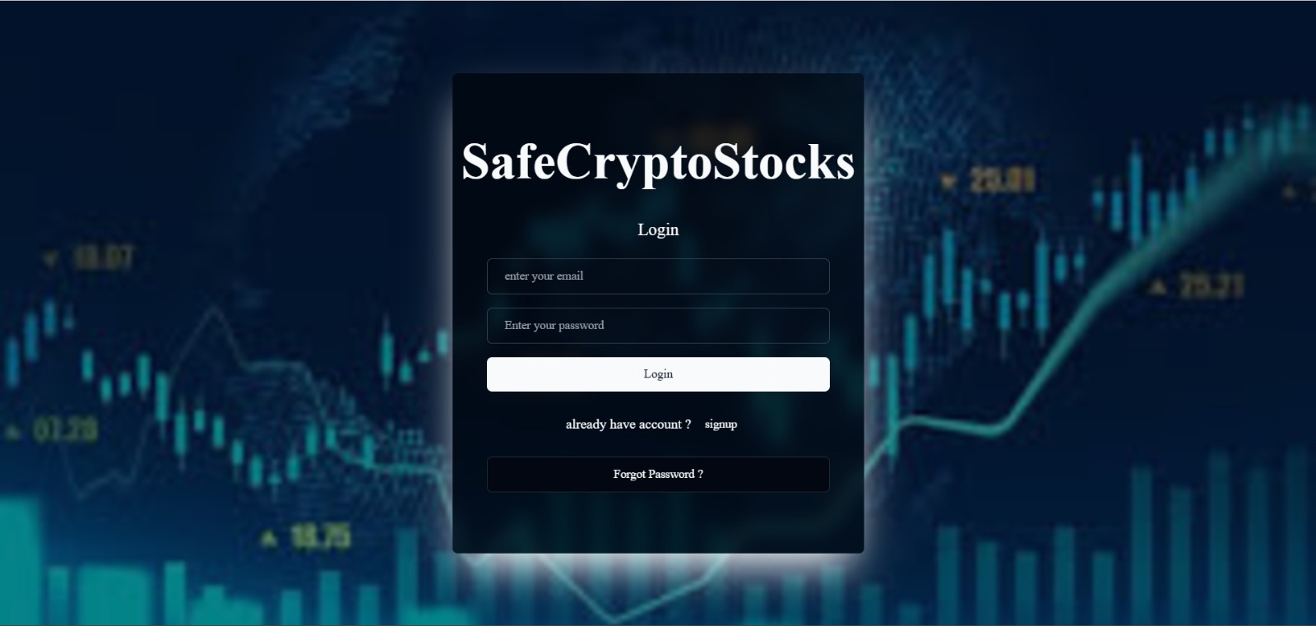
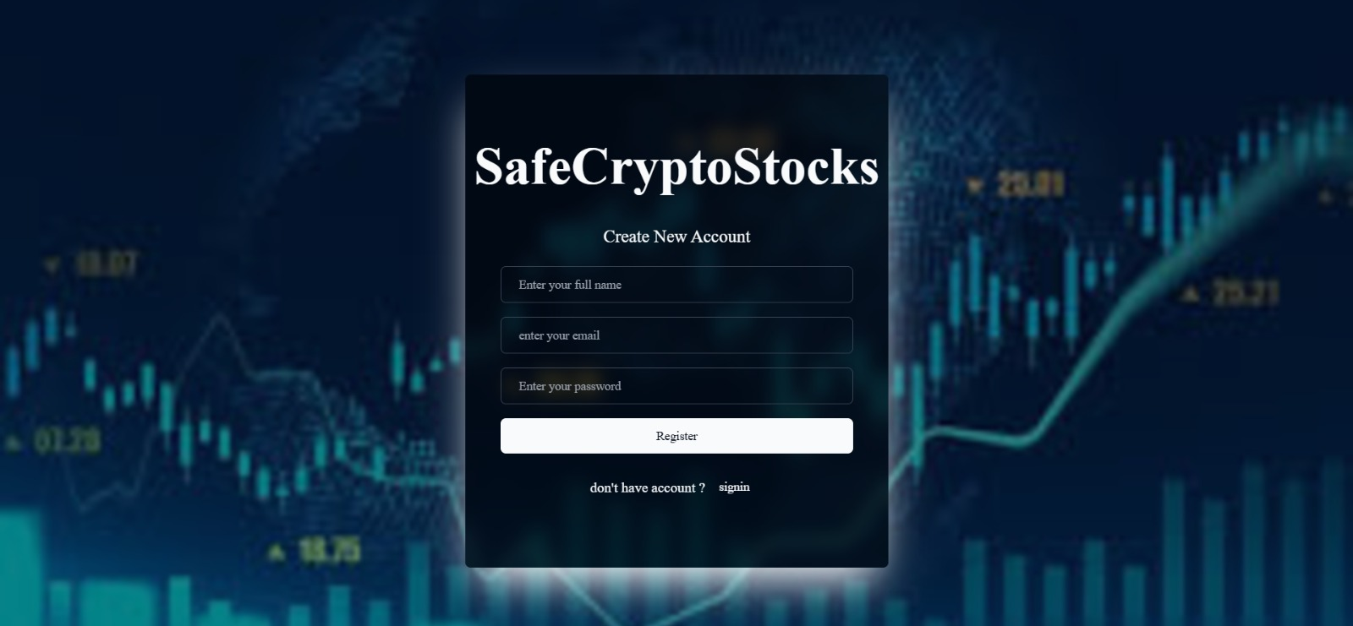
MODULE IMPLEMNTED
SAFE CRYPTO STOCKS
User Authentication
LOGIN AND REGISTER PAGE:

Slide 10
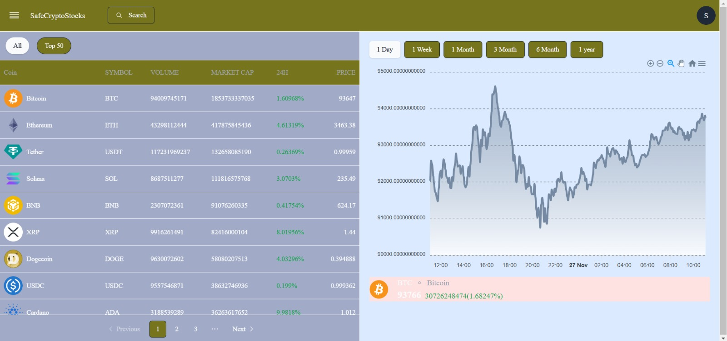
DASHBOARD PAGE:
SAFE CRYPTO STOCKS
Platform Overview: "Safe Crypto Stocks" provides a comprehensive interface for tracking cryptocurrency market trends with detailed data and visualizations.
Key Features: Displays critical metrics like Coin Name, Symbol, Volume, Market Cap, 24-Hour Change, and Price, along with a customizable chart for trend analysis.
User Interaction: Offers features like a search bar, "Top 50" filter, pagination, and time-based trend selection (1 Day, 1 Week, etc.) for a personalized experience.

Slide 11
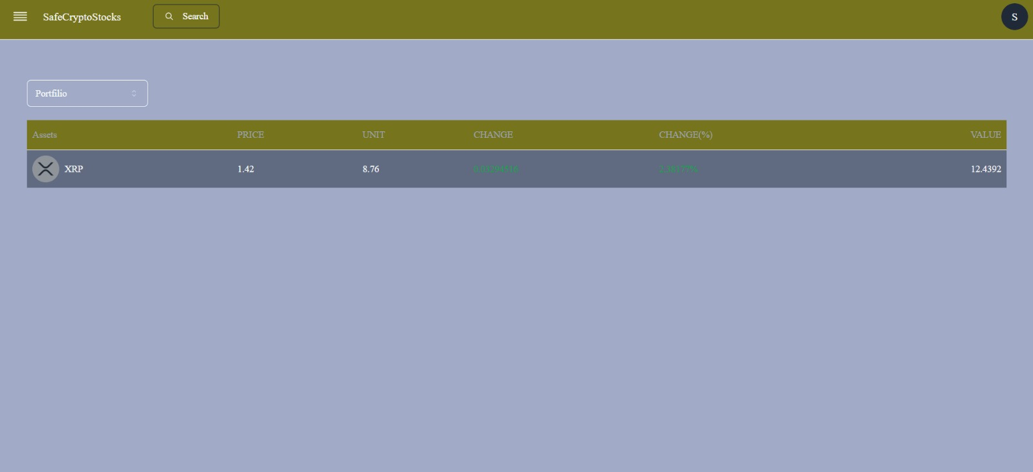
PORTFOLIO PAGE:
SAFE CRYPTO STOCKS
Portfolio Overview: This page displays a user's cryptocurrency portfolio, offering a clear view of their holdings.
Detailed Metrics: It includes columns for Assets (coin name and logo), Price, Units owned, Change (value and percentage), and Total Value of the asset.
Focused Display: The page currently shows details for a single cryptocurrency, XRP, emphasizing its real-time value and performance.

Slide 12
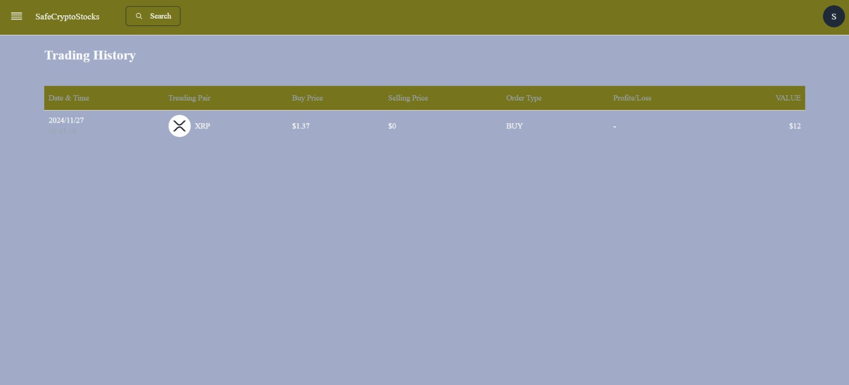
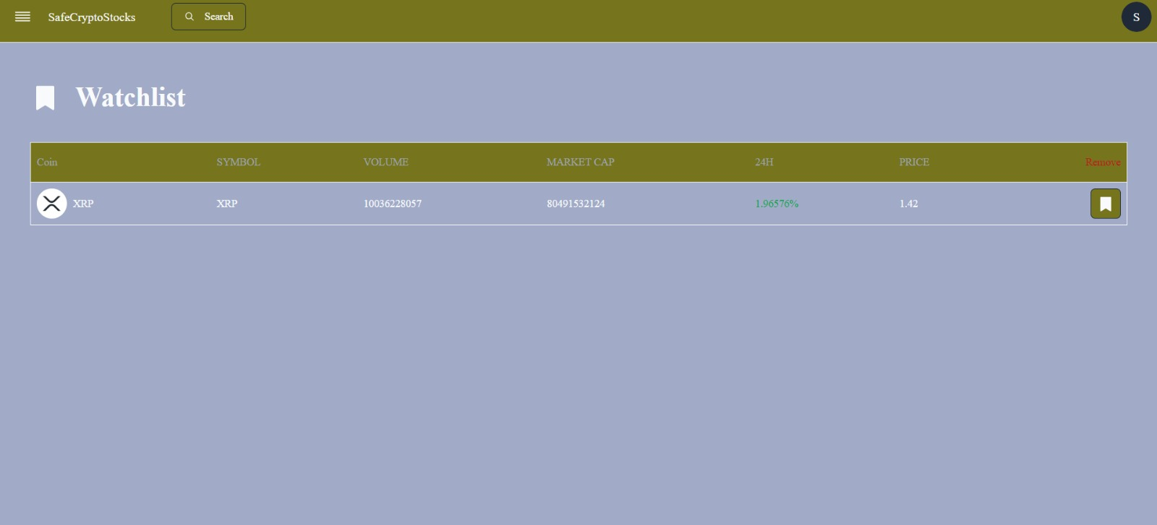
History:
SAFE CRYPTO STOCKS
Watch List

Slide 13
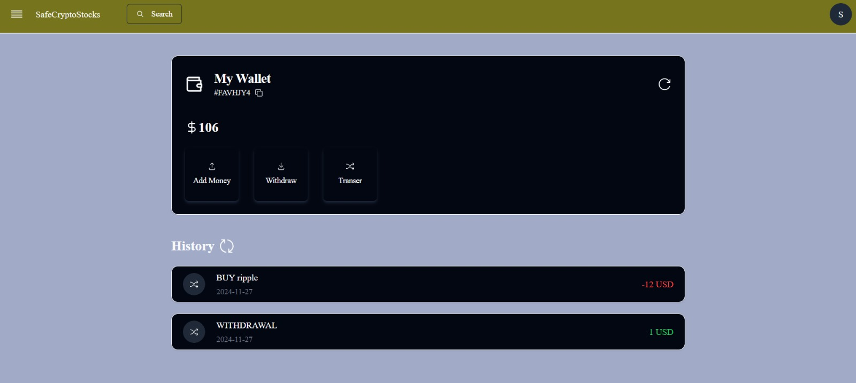
PAYMENT:
SAFE CRYPTO STOCKS
Transaction Options: It offers three key functionalities — Add Money, Withdraw, and Transfer — for seamless management of funds.
Transaction History: A section at the bottom shows recent activities with details, such as buying XRP (-12 USD) and a withdrawal (+1 USD), along with timestamps for each transaction.

Slide 14
CONCLUSION
SAFE CRYPTO STOCKS
The Stock Market Investment Platform simplifies stock market investing by providing users with real-time market data, portfolio management tools, and learning resources. It empowers users to make informed investment decisions, track their performance, and enhance financial knowledge—all within a secure and user-friendly environment.

Slide 15
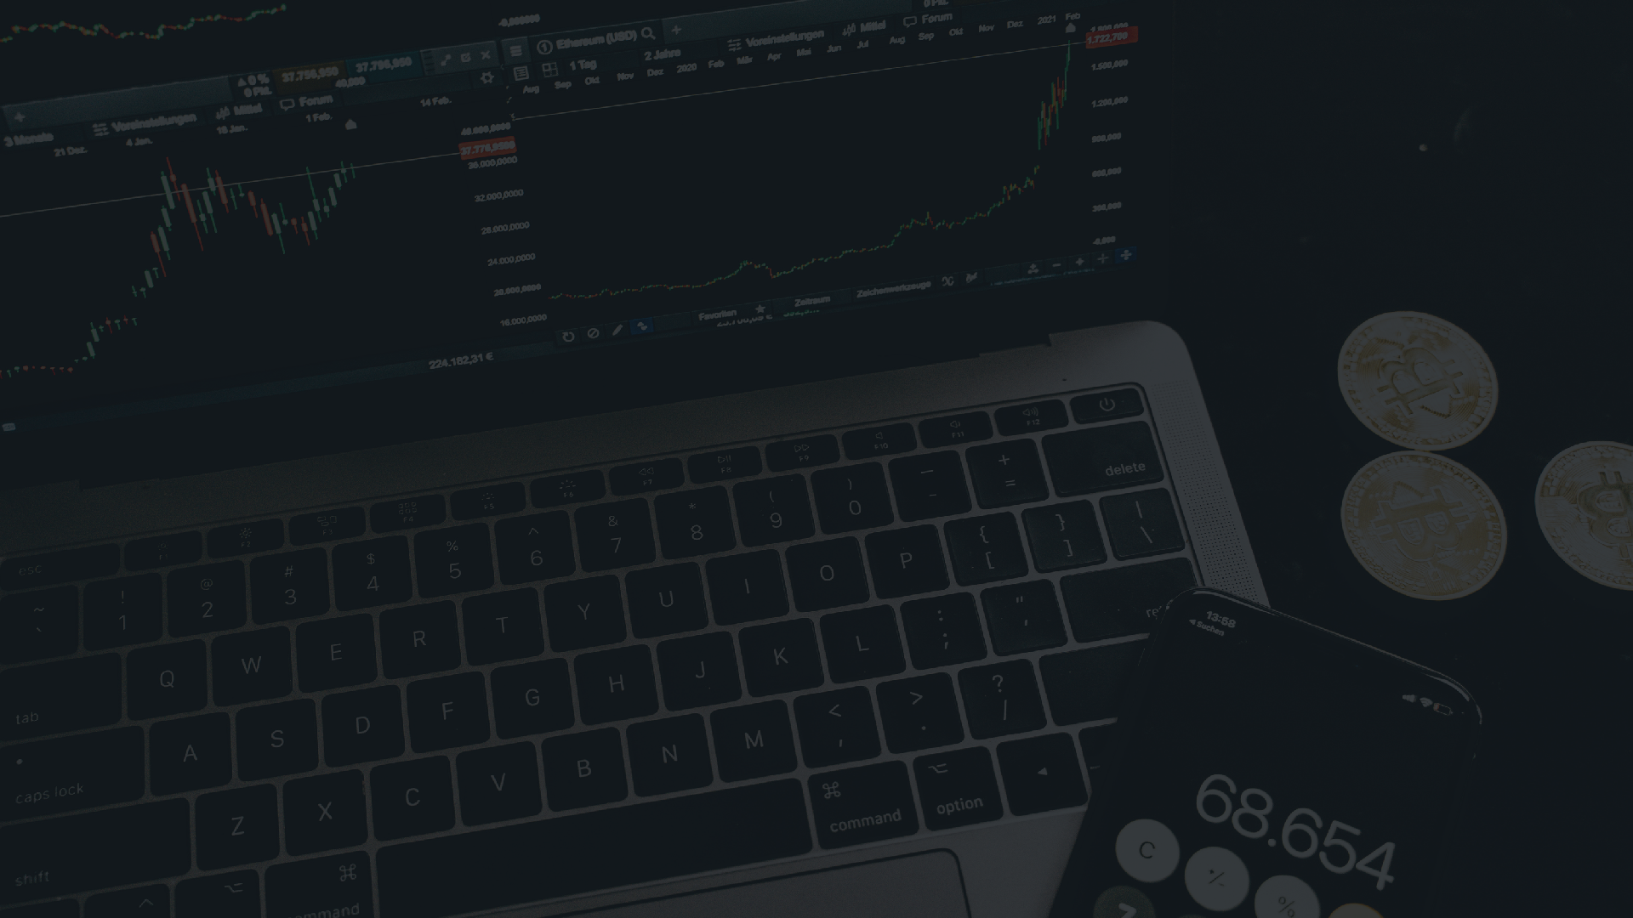
THANK YOU !
SAFE CRYPTO STOCKS

